Slide 1

Java Basics II
EE422C - Software Design and Implementation II

Slide 2
Java Basics II
Memory Allocation
Reference Types
Wrapper Classes
Strings

Slide 3
But first…
Access Specifiers (public, private, protected)
Portability
Pointers and memory addresses

Slide 4

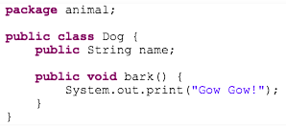
Access Specifiers
Notes:
First a quick recap..
Java is an OOP language. OOP involves working with objects. Objects are instances of classes. Classes are blue-prints of objects.
We can have a class for Car, a class for Boat and a class for Airplane.
In Java, we can organize these classes, for example by type, into packages.
When we want to use a class from a package, we can import a package.
What are access specifiers?
Access specifiers are keywords to control the accessibility to classes, interfaces, fields, constructors and methods
What are they? From less restrictive to more restrictive

Slide 5

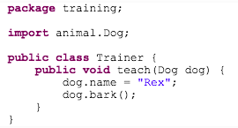
Access Specifiers: Public
Different packages
Member and method
are public
OK
Notes:
the Dog and Trainer classes are in 2 different packages: animal and training, respectively. Because the Dog class is declared as public, and also its member name field and bark() method, the Trainer class can invoke them

Slide 6

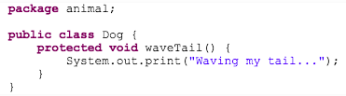

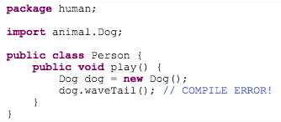
Access Specifiers: Protected 1
Different packages
Method is protected
ERROR
Notes:
Not in the same package

Slide 7

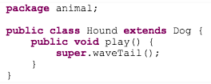
Access Specifiers: Protected 2
Same package
Subclass
OK
Notes:
Not in the same package

Slide 8

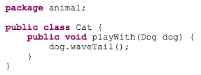
Access Specifiers: Protected 3
Same package
OK
Notes:
Not in the same package

Slide 9

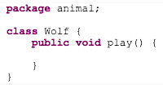

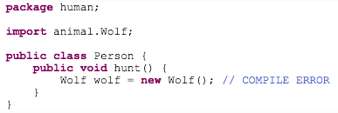
Access Specifiers: Default
Different package
ERROR
Notes:
No access specifier indicated, it’s default.

Slide 10

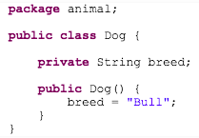

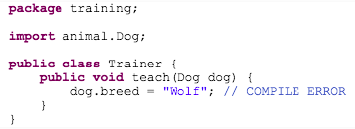
Access Specifiers: Private
Member only accessible within its class
ERROR
Notes:
No access specifier indicated, it’s default.

Slide 11
Access Specifiers
Which one to use?
Always apply most restrictive specifier unless you have a good reason not to
Private member variables and public methods
Notes:
No access specifier indicated, it’s default.

Slide 12
Pointers and Addresses
Statement that alluded to the fact that it was not possible to access memory addresses in Java
Clarify: it is not possible to cause major havoc with memory addresses in Java
Reference types store memory addresses of objects, but Java limits how these can be used

Slide 13
Memory Allocation
Three chunks of memory
Static:
program, static variables
Stack:
method activation record (local vars, params, info about method)
Heap:
anything that is dynamically allocated (i.e., new)

Slide 14
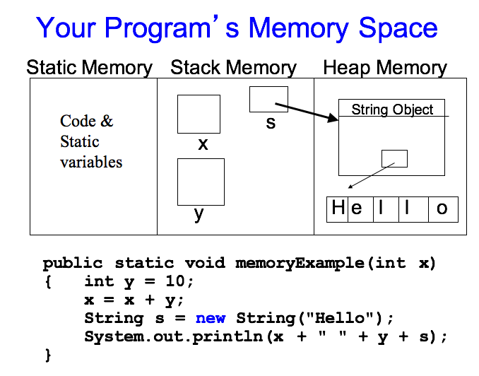

Slide 15
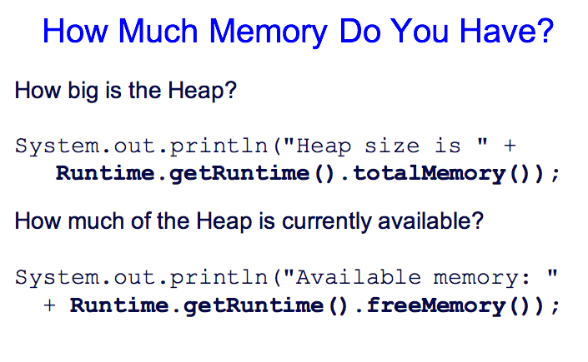

Slide 16
Reference Variable Data Types
Objects behave differently than the primitive types
Only four basic actions that can be applied:
Apply a type conversion
Access an internal data field if its visible
Call a visible method via the dot operator (.)
Use the instanceof operator

Slide 17
Reference Variable Data Types
Which actions cannot be applied?
Object_A * Object_B
No logical meaning: not allowed
Object_A + Object_B
No guarantee it is an object
In C/C++, arithmetic on pointers is allowed
This often leads to sadness

Slide 18
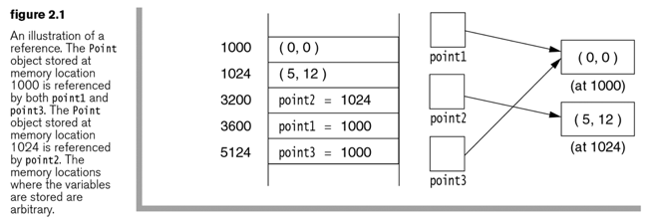
Reference Variable Data Types

Slide 19
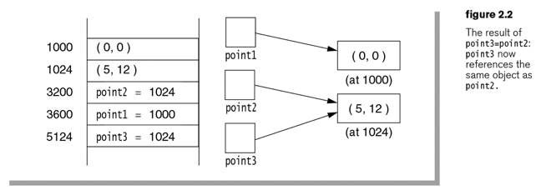
Reference Variable Data Types

Slide 20
Simple Object Declaration & Creation
public class Circle
{ private double radius;
public Circle(double r)
{ radius = r;} //constructor
public double getRadius()
{return radius; }
public void setRadius(double r)
{radius = r; }
public double getArea()
{ return Math.PI * radius * radius; }
public double getPerimeter()
{return 2.0 * Math.PI * radius;}
}

Slide 21
Simple Object Declaration & Creation
// in the main method of the driver class
. . .
Circle myCirc;
myCirc = new Circle (2.0);
double theArea = myCirc.getArea();
double thePerim = myCirc.getPerimeter();
. . .
myCirc = null; //what happens?
What happens to myCirc?

Slide 22
More about Reference Types
Assignment (=)
Values are copied from rhs to lhs
For objects it’s the address of that is copied
Equality testing (==)
For object vars it is testing the equality of the addresses, not the objects referred to
Use an “equals” method for that purpose
if (string1.equals(string2)) . . .
Parameter passing (when calling a method)
For reference vars, the address is passed

Slide 23
Wrapper Classes
Classes that encapsulate a primitive type within an object
Along with autoboxing/unboxing, and the various conversion methods this allows the mixture of primitives and objects in expressions
Builtin wrapper classes are:
Double
Float
Integer
Long
Short
Byte
Character
Boolean
They contain methods that allow us to fully integrate the primitive types into Java’s object hierarchy

Slide 24
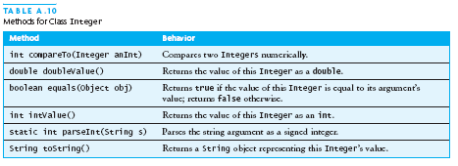
Wrapper Class for Integers
As well as constructors for integer values

Slide 25
Autoboxing and Auto-unboxing
When a primitive type is automatically encapsulated (boxed) into an equivalent object type wrapper when needed
Or done explicitly like
Integer.parseInt (stringVariable)
When the value of a boxed object is automatically extracted into a primitive value when needed
Example
Integer i1 = new Integer (1234);
int i2 = 33;
i1 = i1 + i2:
System.out.println(i1);

Slide 26
String Objects
Strings are represented by objects (String)
String variables are declared and may be initialized
String name = “Ned Logan”;
Same basic operations as all reference vars, except +
A String is a composite data object built from instances of the primitive data type char (in Unicode)
String objects are immutable
Static quoted strings are automatically converted into String objects.

Slide 27
What do we do with Strings?
Input and output them
Make a bigger String out of little ones
Break big Strings into smaller ones
Do comparisons (like in chars)
Extremely useful in any application that manipulates text (e.g. translators, word processors, language puzzles, etc.)

Slide 28
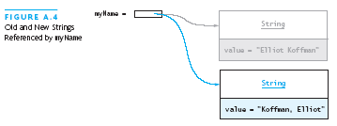
The String Class
You cannot modify a String object
If you attempt to do so, Java will create a new object that contains the modified character sequence
String myName = “Elliot Koffman”;
myName = “Koffman, Elliot”;

Slide 29
How characters are stored in Strings
Each character in a String is in a sequential position.
Each position has a number starting with position 0
String name = “Ned Logan”; // is stored as:
Position #
0 1 2 3 4 5 6 7 8
String
contents
N e d L o g a n
The number above each character specifies its position number (sometimes called its index number) in the sequence
Each character is Unicode

Slide 30
Escape sequences
escape sequence: A special sequence of characters used to represent certain special characters in a string.
\t tab character
\n new line character
\" quotation mark character
\\ backslash character
Example: System.out.println("\\hello\nhow\tare \"you\"?\\\\");
Output: \hello how are "you"?\\

Slide 31
String Methods
There are lots of useful operations and library methods found in the String class
Checking length, extracting single chars, extracting substrings, concatenation
String greeting = "hello";
int len = greeting.length( ); // len is 5
char ch = greeting.charAt( 1 ); // ch is 'e'
String sub = greeting.substring( 2, 4 ); // sub is "ll”
String age = “9”;
String s = “He is ” + age + “ years old”;
System.out.println (s); // He is 9 years old

Slide 32
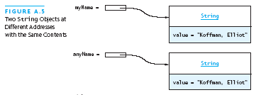
Comparing Objects
You can’t use the relational or equality operators to compare the values stored in strings (or other objects)
(You will compare the pointers, not the objects!)
if (myName == anyName) …..
if (myName.equals(anyName)) …..

Slide 33
Conversions
To convert a number to String format you can simply concatenate it with the empty String
String numString = “” + 7;
Or use toString method in the appropriate wrapper class
String numString = Integer.toString (7);
To convert a String to a number you need the help of some special methods found in the wrapper classes
String aString = “24”;
int age = Integer.parseInt (aString);
aString = “75.99”;
double price = Double.parseDouble (aString);
If a String does not have a legal numeric value then your program throws an exception
toString() also works on converting objects to string

Slide 34
Some Useful String Methods - for searching, picking apart, comparing, etc. -
All are called for a reference string variable: str.method(args)
substring (start) - Returns the substring of the reference String starting at index start through the end of the String.
substring (start, end) - Returns the substring of the reference String starting at index start through index end-1.
indexOf (a) - Returns the index (int) of the first occurrence of String a or char a in the reference String. Returns -1 if not found.
indexOf (a, start) - Returns the index (int) of the first occurrence of String a or char a in the reference String that occurs at or after index start.
equals (String) - Test two Strings for equality (boolean)
compareTo (String) - tests two Strings for lexicographical ordering; returns an int for <, >, =

Slide 35
More String methods
Comparison methods: string1 and string2 are String variables with values
boolean results = false; // results is a boolean variable
If (string1.equals(string2)) results = true;
// true if same contents
If (string1.equalsIgnoreCase(string2)) results = true;
//true if same contents without considering capitalizations
String searching methods
String str = “Now is the time for all good men ” +
“to come to the aid of their country.”;
int i = str.indexOf (“the”); // i = 7
int j = str.lastindexOf (“the”); // j = 55
Upper and Lower case conversion
toUpperCase, returns an all uppercase version of the String
toLowerCase returns an all lowercase version of the String

Slide 36
Advanced String Operations
StringBuilder class
Like String but not immutable, can expand/contract
StringBuffer class
Mutable and safe for use by multiple threads.
StringTokenizer class
Used to break up a String into “tokens” - beware of delimiter issues - cannot always use this easily
String formatting
Like using sprintf () in C - the format specification follows the same rules
Browse the Java API for more string operations

Slide 37
Questions

